Slide 1


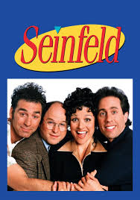







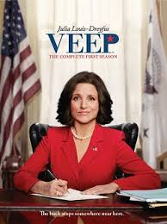

Seinfeld (Jerry)
Big Bang Theory
Friends
Grey’s Anatomy
Young Sheldon
Curb (Larry)
The West Wing
Grace and Frankie
VEEP
Poldark

Slide 2






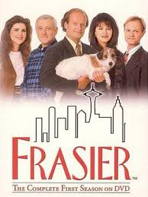





Modern Family
The Office
CBS Evening News
Frasier
Downton Abbey
Parks and Recreation
Shows to add:
Cheers
Yellowstone
M*A*S*H

